Slide 1

GENEGUIDE AI
AI-Based Prenatal Genetic Risk Assessment and Decision Support System
Final Review
Team Members
Project Guide
Mohamed Ismail - 24623118
Veerapuvin S - 24623155
Sakthibalan G - 24623145
Ms. Benasir Begam.F M.E, (Ph.D)
Batch No: 10

Slide 2
Abstract
GeneGuide AI is an AI-based prenatal genetic risk assessment and decision-support system that analyzes prenatal, family-history, and genetic factors. It uses a Random Forest classifier to classify cases into Low, Moderate, or High risk categories.The model was trained on 1,250 synthetic records with 14 input features and achieved 85.2% accuracy on 250 test records. A Flask and SQLite web application allows users to enter assessment details, view the predicted risk, and maintain their assessment history. The system is developed as an educational prototype to support preliminary risk assessment and is not intended for medical diagnosis

Slide 3
Problem Statement
Prenatal genetic risk depends on many factors at once.
Weighing several factors by hand is complex and time-consuming.
Family history and previous pregnancy details are hard to evaluate together.
Genetic screening information needs proper interpretation.
There is scope for an AI-assisted system that organizes these factors and gives an understandable, preliminary risk category.
"How can machine learning combine selected prenatal, family-history and genetic factors to give an understandable prenatal genetic risk assessment?"

Slide 4
Objectives
Develop an AI-based prenatal genetic risk assessment system.
Analyze selected maternal, paternal, pregnancy, family-history and genetic factors.
Use a Random Forest model to classify risk as Low, Moderate or High.
Give understandable information about the factors behind the prediction.
Build a user-friendly, web-based decision-support prototype.
GeneGuide AI is an educational prototype. It is not a medical diagnosis.

Slide 5
Literature Survey
No. | Author & Year | Paper / Method | Methodology | Limitation | Our Contribution
1 | Yuan et al., 2025 | DBNX | DBN + XGBoost | General risk prediction, not prenatal-specific | Prenatal risk model using clinical + genetic factors
2 | Neocleous et al., 2016 | First Trimester Noninvasive Prenatal Diagnosis | ANN | First-trimester focus, limited factors | Broader prenatal and family-history factors
3 | Neocleous et al., 2017 | Intelligent Noninvasive Diagnosis of Aneuploidy | ANN | Aneuploidy focus, specific disorders | Low / Moderate / High risk classification
4 | Li et al., 2019 | Down Syndrome Prediction | Cascaded ML | Down syndrome focus, single disorder | Broader genetic-risk assessment
5 | Salini et al., 2024 | Fetal Health Classification (CTG) | Multiple ML models | CTG-based, not genetic-risk focused | Combines prenatal, family-history and genetic factors
6 | Susanto et al., 2023 | ML-based Clinical Decision Support | Scoping review | Most studies report only offline accuracy | Delivered as an end-to-end, usable web tool
7 | Miroševič et al., 2022 | Family History Tools in Primary Care | Systematic review of 26 tools | Validity poorly reported; few self-administered | Self-administered family-history web questionnaire

Slide 6
System Architecture
User (Web Browser)
Login and registration
Assessment form (14 inputs)
Result page
History page
Flask Web Server (app.py)
Checks the input values
Encodes the categories
Runs the Random Forest model
Saves the result
SQLite Database
users table
assessments table
inputs
save
risk level
history
loaded when the app starts
Model training
Synthetic dataset (1,250 records)
Data preprocessing
Label encoding
80 / 20 train-test split
Random Forest (200 trees)
Saved model and encoders (.pkl)

Slide 7
Proposed Methodology
1. Dataset preparation
Synthetic, medically informed dataset: 1,250 records, 14 features, target Risk_Level (Low / Moderate / High).
2. Data preprocessing
Check the fields. Keep the text value "None" as a real category so it is not read as a missing value.
3. Feature encoding
A separate LabelEncoder for each of the 9 categorical features, saved with joblib for reuse.
4. Train-test split
80 / 20 stratified split: 1,000 training and 250 test records (random state 42).
5. Model training
Random Forest classifier with 200 trees, fitted on the training split only.
6. Performance evaluation
Accuracy, precision, recall, F1-score and confusion matrix on the 250 unseen test records.
7. Risk classification
Validate the inputs, encode them, predict, then convert the label to Low, Moderate or High.
Random Forest was chosen because it handles mixed categorical and numeric data, resists overfitting better than a single tree, and can later show feature importances.

Slide 8
Hardware and Software Requirements
Hardware
Software
Laptop / Desktop
4 GB or more RAM
Modern processor
Adequate storage
Internet connection
Python
Flask
Werkzeug
Pandas
NumPy
Scikit-learn
Joblib
Matplotlib
HTML
CSS
JavaScript
SQLite
VS Code

Slide 9
Dataset and Input Features
Synthetic, medically informed dataset: 1,250 records, 14 input features and one target (Risk_Level).
Class | Records | Share
Low | 285 | 22.8%
Moderate | 650 | 52.0%
High | 315 | 25.2%
Feature group | Inputs
Demographic and pregnancy (3) | Mother's age, father's age, pregnancy week
Family history (4) | Family history (yes / no), affected family members, type of family history, carrier status
Genetic testing and obstetric history (7) | Parental genetic test result, previous child with a genetic disorder, previous abnormal pregnancy, consanguineous marriage, previous miscarriages, multiple pregnancy, previous prenatal screening
The data leans toward the Moderate class.

Slide 10
Implementation
Module | What it does
Login and registration | Passwords are stored only as hashes. Pages are protected by login.
Assessment form | 14 fields in three sections, with range checks on the numbers.
Prediction | Validates the inputs, encodes them and runs the Random Forest model.
Result page | Shows the risk level, why it may have occurred, and a medical disclaimer.
History | Saves every assessment in SQLite. Each user sees only their own.
Built with Python, Flask and SQLite. All SQL queries are parameterized.

Slide 11
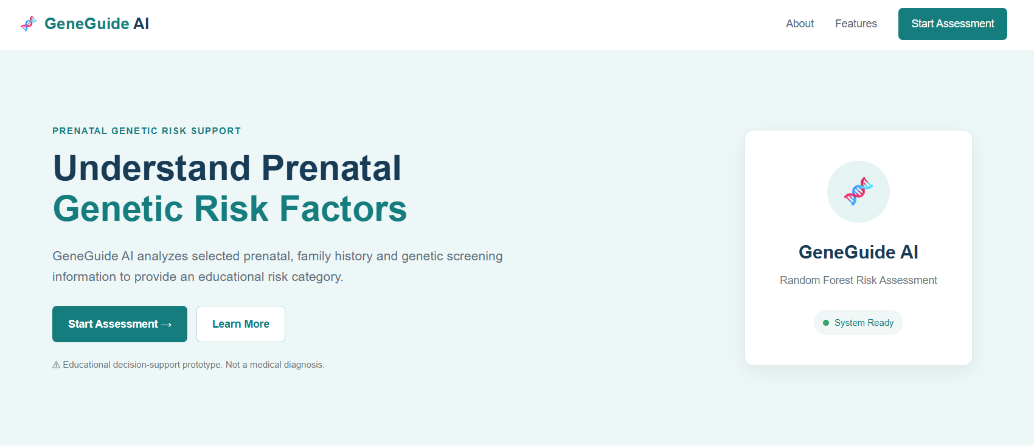
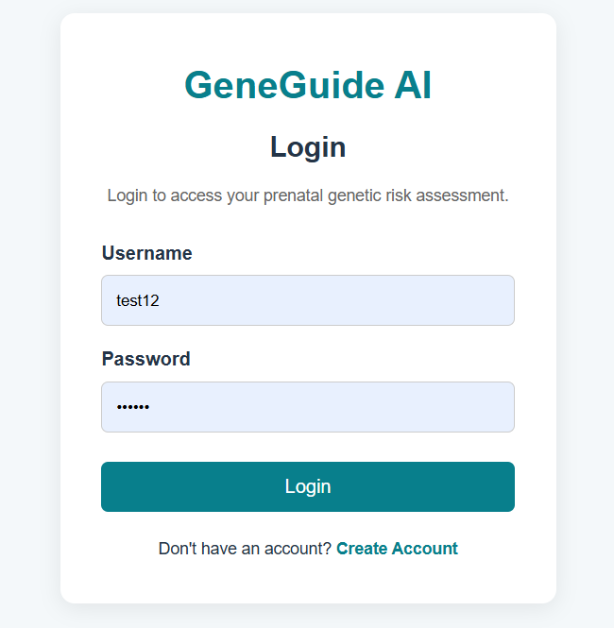
Implementation: Home and Login
Home page
Login page
Introduces the project and states that it is an educational prototype, not a medical diagnosis.
Sign in or create an account.

Slide 12
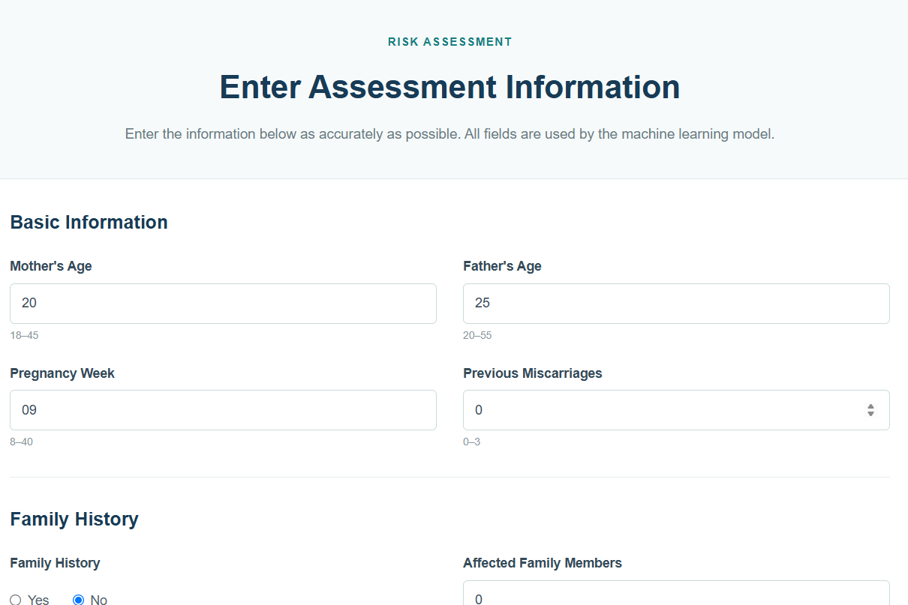
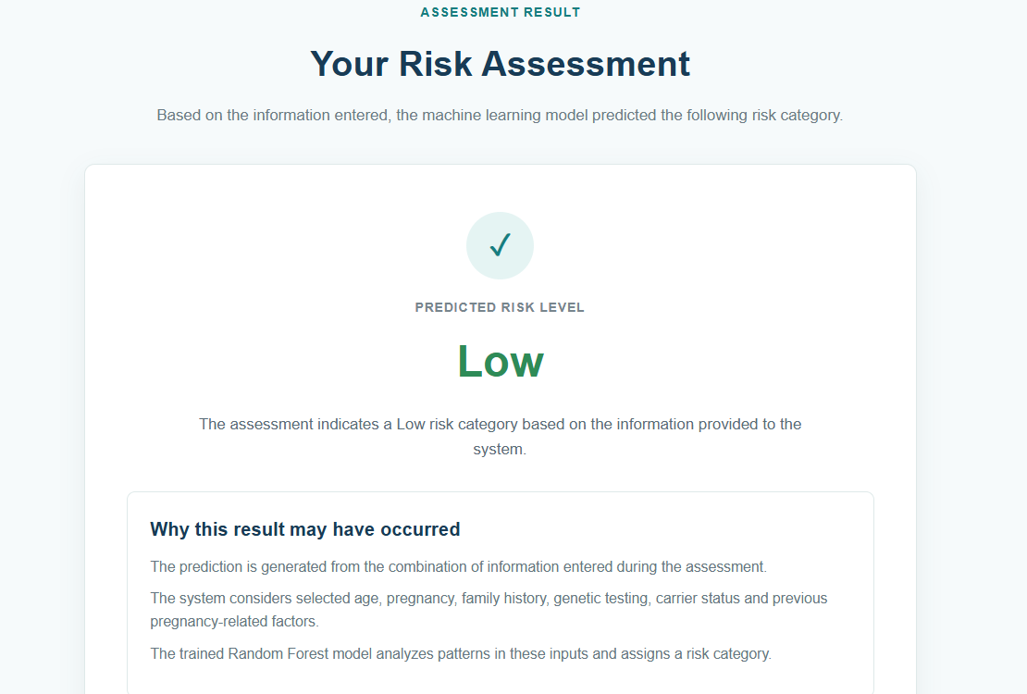
Implementation: Assessment and Result
Assessment form
Result page
Three sections: basic information, family history, genetic and pregnancy details.
Shows the predicted risk level (here: Low) and why the result may have occurred.

Slide 13
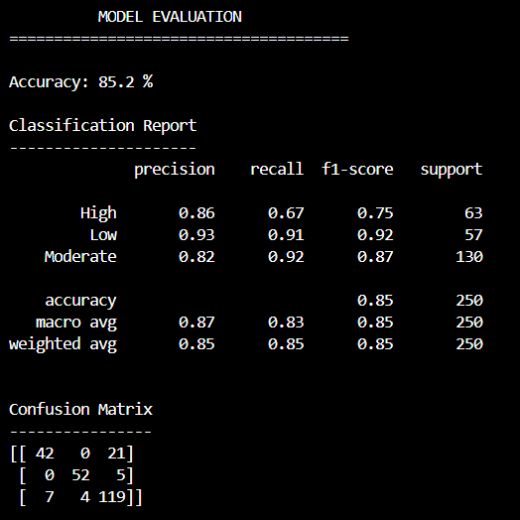
Results
Overall accuracy: 85.2% on 250 test records
Class | Precision | Recall | F1-score | Support
Low | 0.93 | 0.91 | 0.92 | 57
Moderate | 0.82 | 0.92 | 0.87 | 130
High | 0.86 | 0.67 | 0.75 | 63
Low risk is predicted best (F1 = 0.92).
Moderate-risk prediction achieved a high recall of 0.92, correctly identifying most Moderate cases.
Low and High risk classes were not directly confused with each other, with the major classification errors occurring between Moderate and the other classes.
Training output (train_model.py)

Slide 14
Limitations and Future Work
Limitations
Future work
Training data is synthetic, not real patient records.
With 1,250 records, High and Moderate cannot be separated finely.
No clinical validation. Accuracy is measured on a split of the same synthetic data.
Inputs far outside the data may give unreliable results without a warning.
Compare Random Forest with other ML models such as Logistic Regression and Decision Tree.
Add k-fold cross-validation for more robust evaluation.
Use more real-world and diverse data with proper clinical validation.
Improve High-risk detection and provide clearer model explanations.
Add a dashboard to track a user's assessments over time..

Slide 15
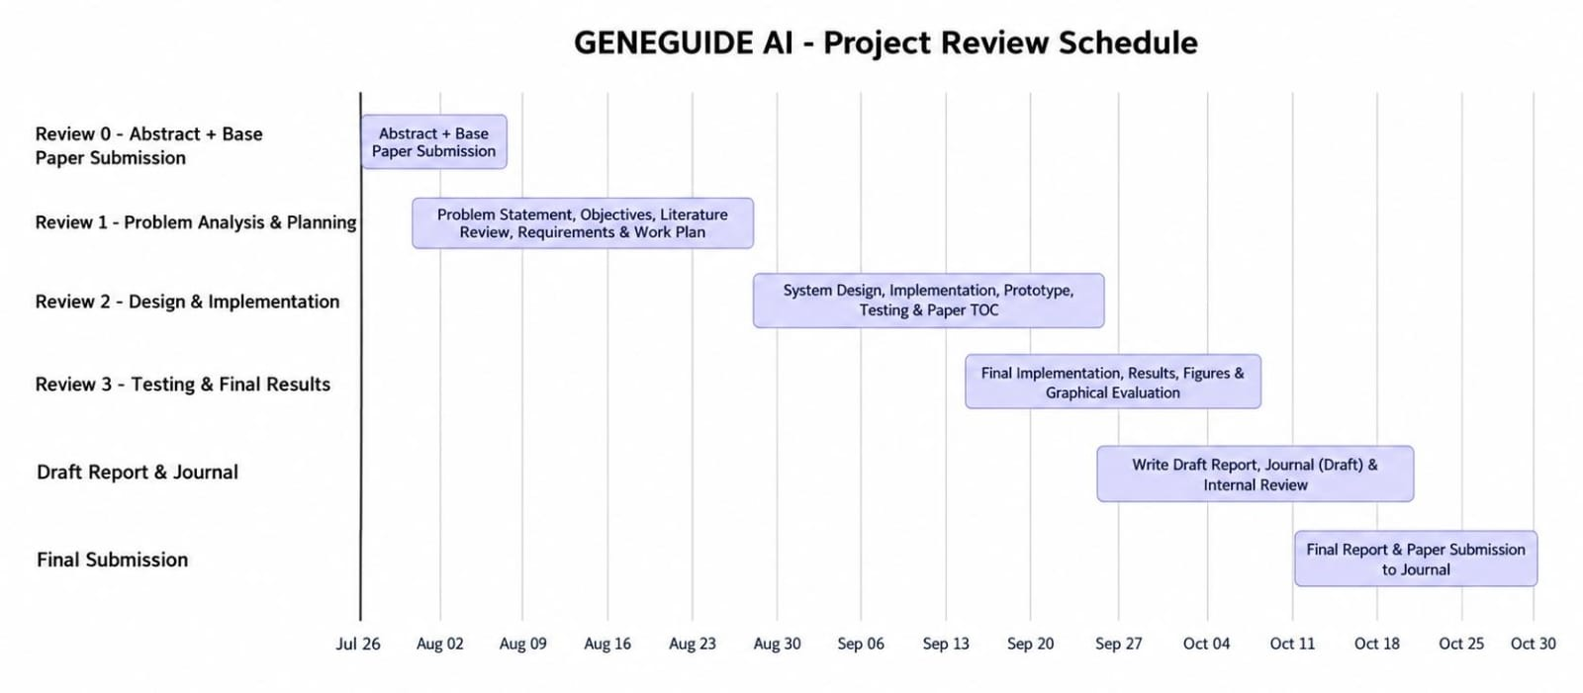
Gantt Chart

Slide 16
Conclusion
GeneGuide AI shows how a Random Forest classifier can be delivered end to end as a simple, self-administered web tool for prenatal genetic risk screening.
A working prototype: login, validated form, prediction, result page and history.
85.2% accuracy on 250 unseen records, with no Low / High confusion.
Educational only: synthetic data, no clinical validation, always consult a doctor.
Next: explainability, model comparison, cross-validation and a larger dataset.

Slide 17
THANK YOU

